Slide 1
TRAGIC HERO IN WILLIAM SHAKESPEARE’S STORY
Name:
Tutor:
Institution:

Slide 2

ROMEO AND JULIET

Slide 3
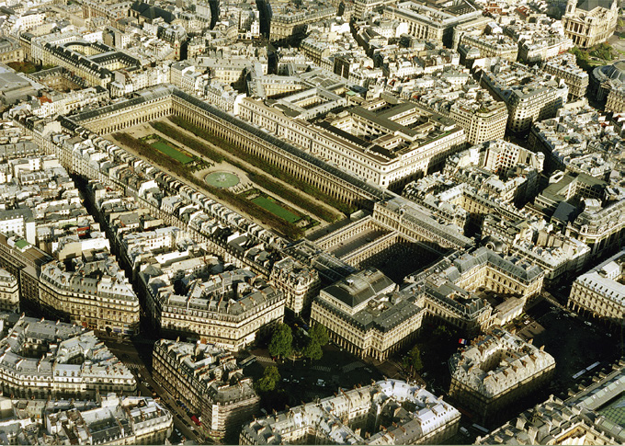
1. BORN OF NOBLE BIRTH
Romeo is born of noble birth for he is a Montague.
The Montague is known to be one of the wealthiest families in Verona which is the place the story of Shakespeare takes place.

Slide 4
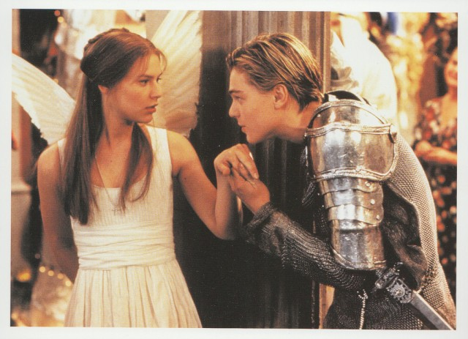
2. INCOOPORATES MANY ADMIRABLE QUALITIES
Romeo is a virtuous and respected character in the play
His love for Juliet is true and risks his life to keep Juliet happy
He is noble and of a high social status similar to that of a prince.
He He is courageous for he stepped in between two fighting men ( Mercutio and Tybalt).

Slide 5
3. DOOMED TO MAKE ERROR OF JUDGEMENT
Romeo has a tragic flaw of being impulsive.
This means he acts without forethought.
First, he attends the Capulet party and kills Tybalt which he was sentenced to banishment for it.
Also, he falls in love with Juliet when some minutes later he was furious that Rosaline would reciprocate her love.

Slide 6
4. RESPONSIBLE FOR OWN FATE
Romeo accepts his mistakes by agreeing to face the consequences for killing someone.
He agrees to be sentenced to banishment for it.

Slide 7
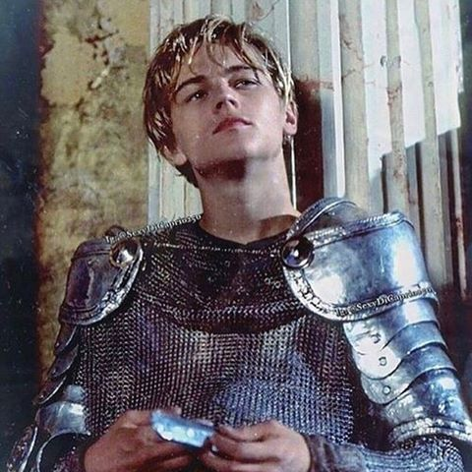
5. FALLS FROM HIGH ESTEEM
Being from a noble and royal family, he falls in love with Juliet who is a capulet which was forbidden.
Being of high esteem, he is sentenced to banishment foe killing.
He also causes deaths for so many characters in the story such; Lady Capulet, Juliet, Tybalt, Paris and himself.

Slide 8
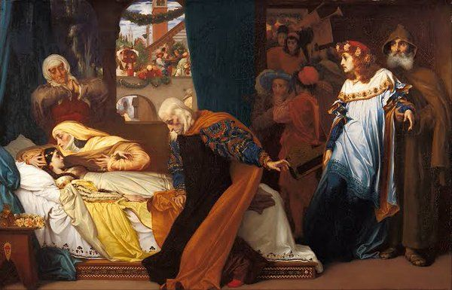
6. Faces and accepts death with honor
Romeo faced death with honor when he realizes that Juliet is dead and decides to follow her by taking the poison.
He died with honor since he had caused deaths for so many characters in the story such; Lady Capulet, Juliet, Tybalt, Paris and himself.

Slide 9
references
Shakespeare, W. (2003). romeo and juliet. Cambridge University Press.

